Slide 1
Associate Engagement

Slide 2
Associate Engagement
Will be divided in 3 projects:
Pop-A-Balloon
SES Comments
Rewards and Recognition

Slide 3
Pop-A-Balloon

Slide 4
The idea
The Associate Engagement Team has now a better way to reward those associates who exceeded expectations or otherwise go the extra mile.
The new rewards platform will provide an interface where the associate will be able to choose and pop a balloon that includes a prize, without needing to physically be in the building.

Slide 5
Behind the Idea
This initiative is being already implemented on site but the work from home associates are not able to participate.
The associate engagement manager sees an opportunity to implement a virtual platform where every associate will be able to be part of it.

Slide 6
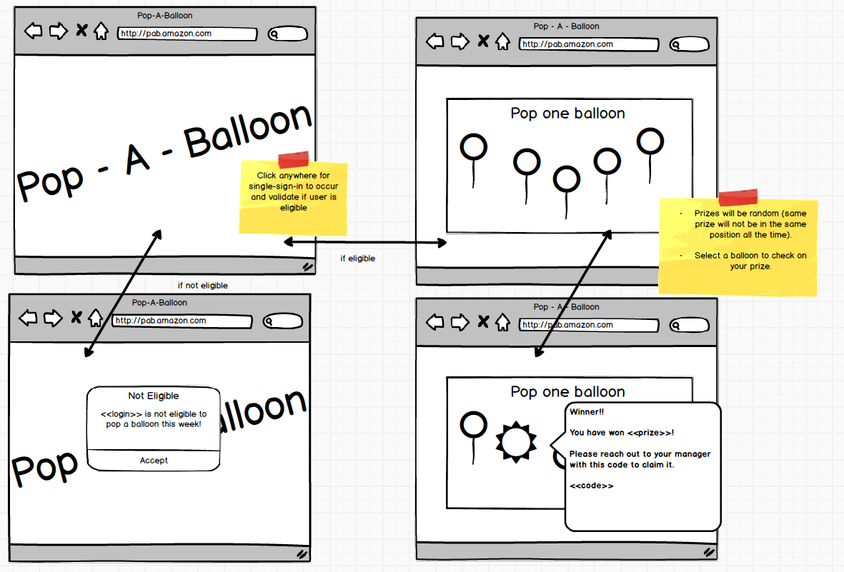

Slide 7
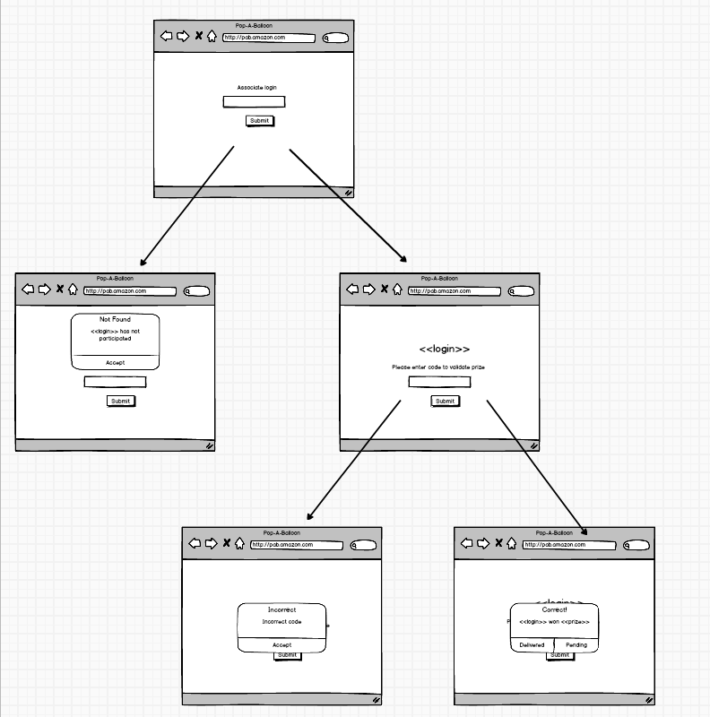

Slide 8
SES Comments

Slide 9
The idea

Slide 10
Behind the idea

Slide 11
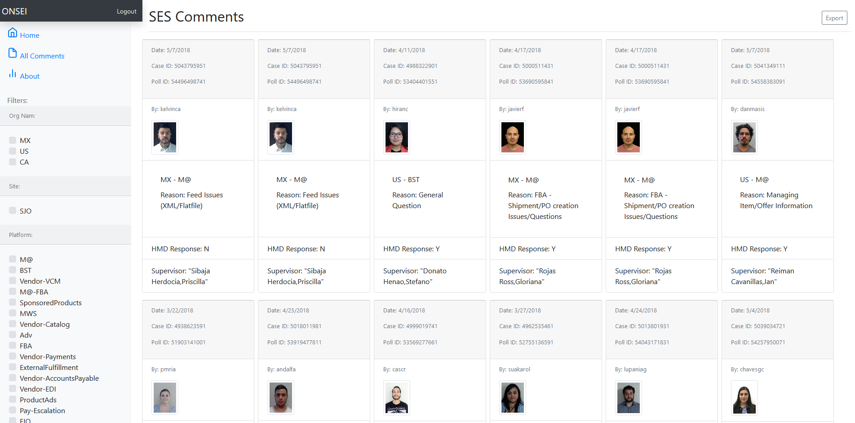
SES Comments

Slide 12
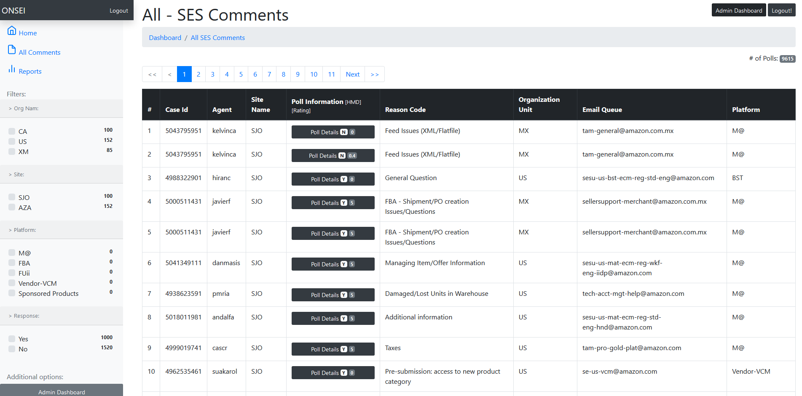
SES Comments

Slide 13
Rewards and Recognition

Slide 14
The idea
Associates will now have a better mechanism for rewards based on their performance.
The Associate Engagement Team (AET) now has a better way to reward those associates who exceeded expectations or otherwise go the extra mile. The new rewards platform will provide a marketplace where the associate will be able to exchange points for a variety of prizes.

Slide 15
Behind the idea
There is currently a recognition program, unfortunately not all associates have been able to participate in it for several reasons, for example, being an associate that works from home makes it very difficult to have access to certain activities that are part of this program.
With this platform we will be able to keep record of each individual progress on tasks, achievements, metrics, etc. Associates will be awarded points by completing tasks or based on their performance, which can be later exchanged on the online store integrated to this tool, depending on the amount of points the associate has earned.

Slide 16
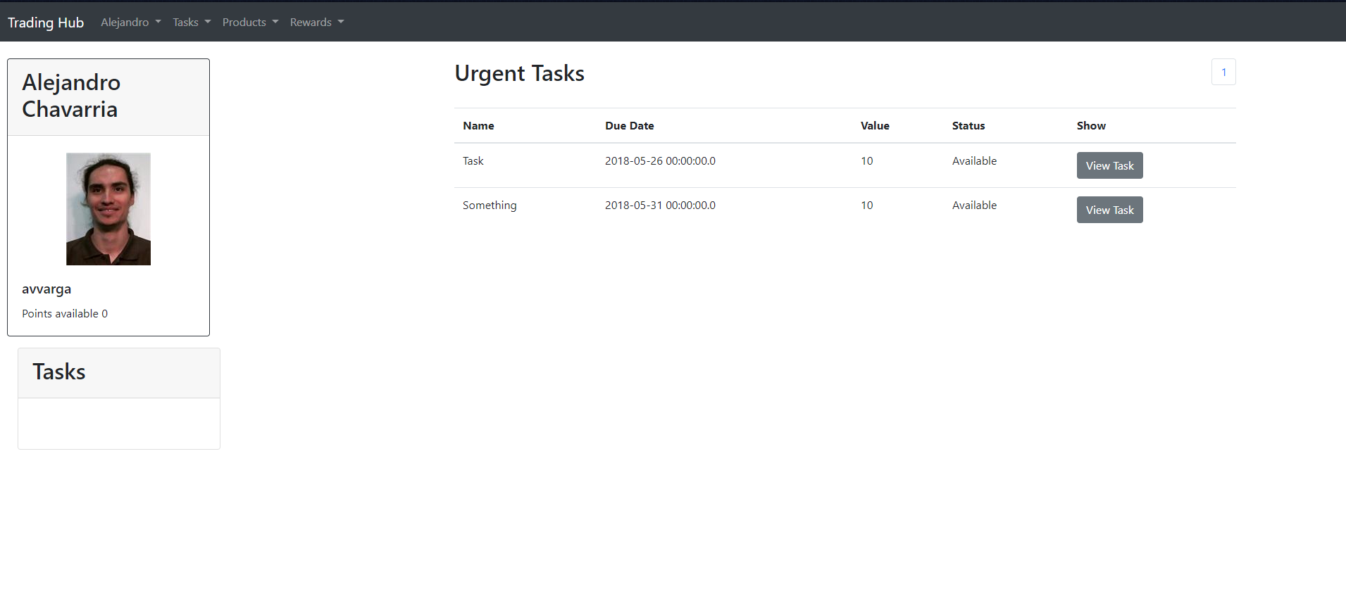
Rewards and Recognition

Slide 17
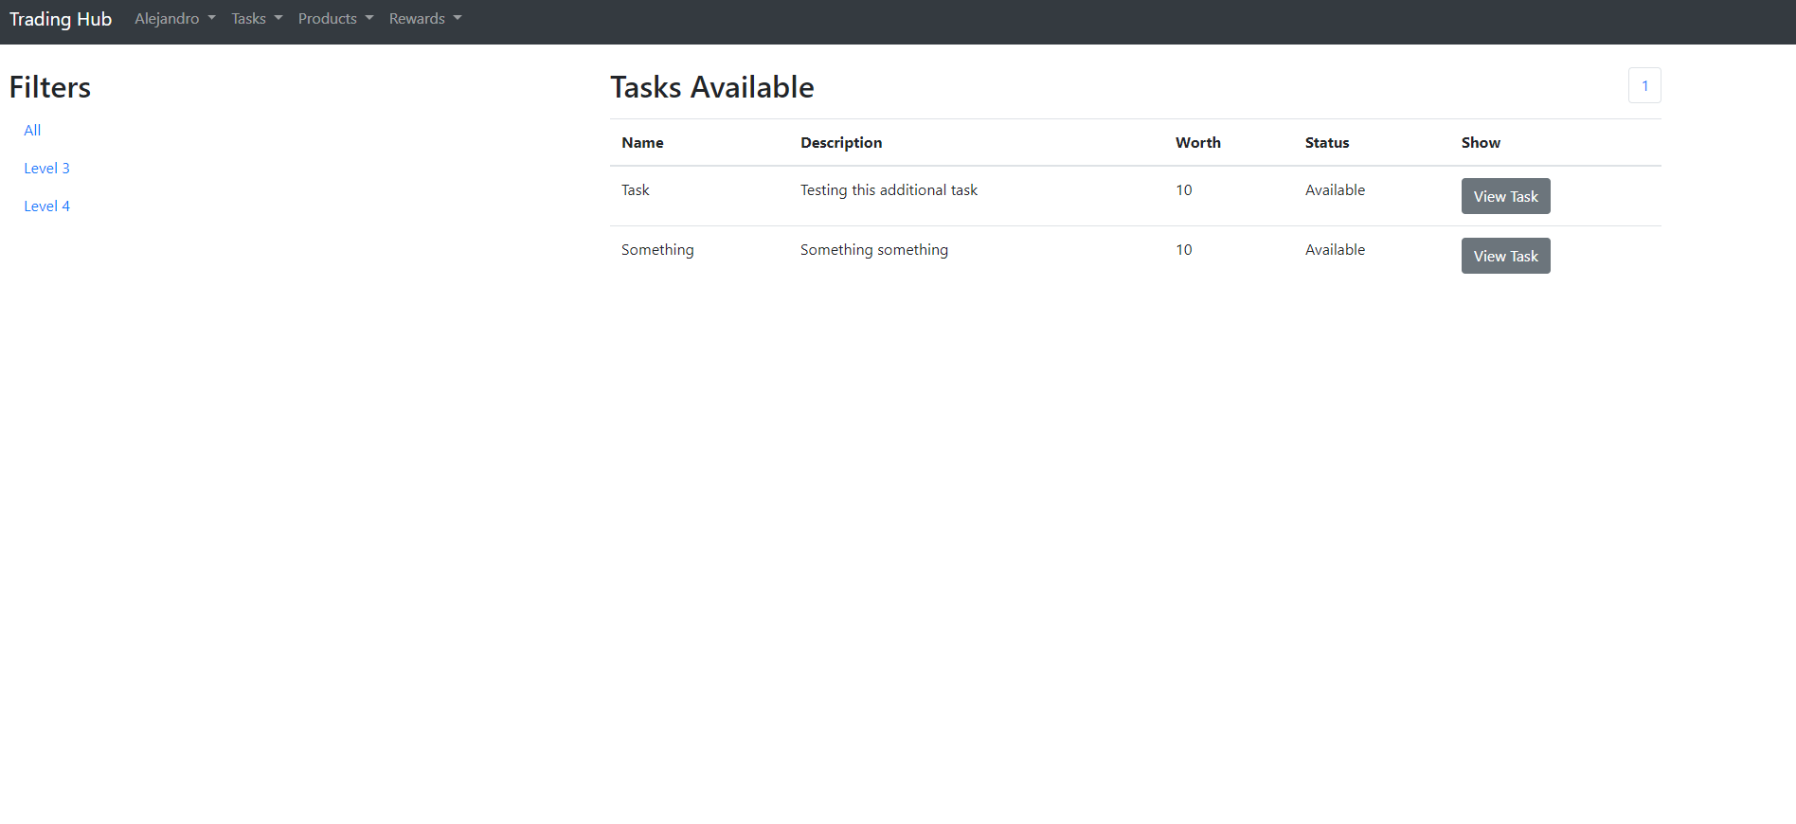
Rewards and Recognition

